Slide 1



Introduction to git scm
www.arobs.com

Slide 2

What is git?
Most widely used modern version control system
Distributed version control system,nearly all operations are local
Strong performance compared to other scm tools(git became “de facto” standard)
www.arobs.com

Slide 3
What can it do for you?
Keep track of all files in a project
Record any changes to project files
Restore previous versions of files
Compare and analyze code
Merge code from different computers and different team members
www.arobs.com

Slide 4
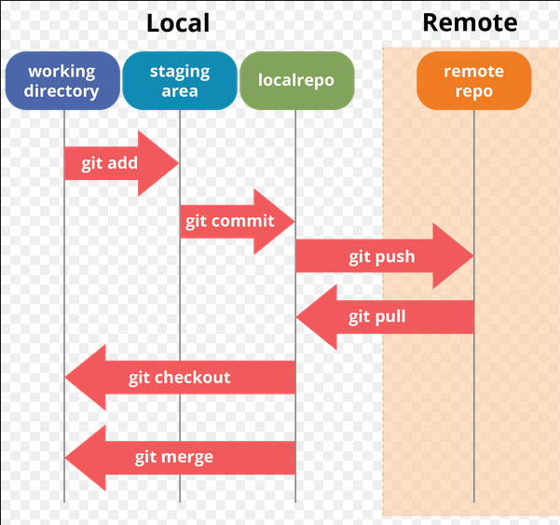
Workflow
www.arobs.com

Slide 5

Configure git
--global command makes it apply for every repository on your PC
www.arobs.com

Slide 6
Obtain a local repository with git
“git init” starts a new local git repository
“git clone” will copy an already existing remote repository to our disk
bitbucket,github. Etc are favourite servers used for holding remote repositories
www.arobs.com

Slide 7
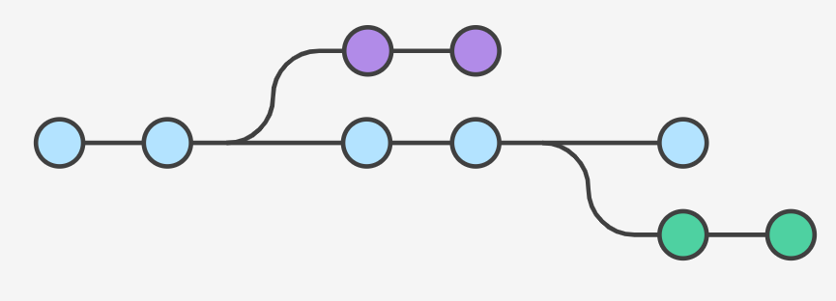
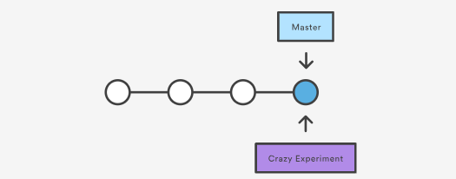
Git branches
A branch represents an independent line of development
Usually tracks origin/”same name branch”
branches are just pointers to commits
www.arobs.com

Slide 8

Git add,git commit
The “git add” command adds a change in the working directory to the staging area
“git commit” is the actual command for making the desired changes to the local repository take effect.
www.arobs.com

Slide 9
Git push,git pull,git merge
- we use “git push” to propagate our local changes on a branch to the tracked remote branch
-we use “git pull” to receive the changes on remote server
-we use “git merge” when we want to incorporate changes from two separate branches,or it is used by git pull when we merge another repository to our local repository
i
www.arobs.com

Slide 10
Useful links
https://git-scm.com/downloads
https://www.syntevo.com/smartgit/download/
https://bitbucket.org/
https://github.com/
https://www.atlassian.com/git
www.arobs.com

Slide 11
Homework
Create an account on bitbucket or github
Store whatever files you accumulated through these trainings on the remote repository with the help of git
www.arobs.com

Slide 12
Q&A
www.arobs.com

Slide 13
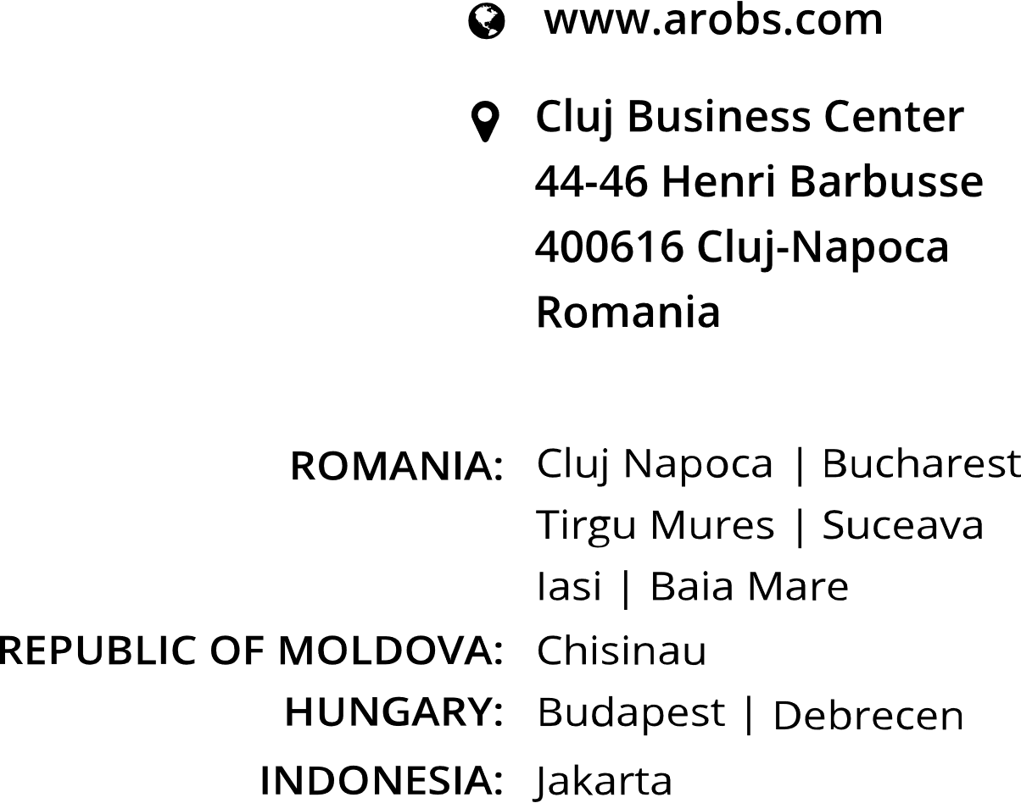


THANK YOU!
GET IN TOUCH
Tamas Norbert
.NET Developer
+40 746 144 380
contact@arobs.com

